Slide 1


Body Mass Index calculator
Exploring the capabilities of Data Science and its use in Healthcare, particularly Body Mass Index.
Presenter: Mattithyahu Owolabi

Slide 2
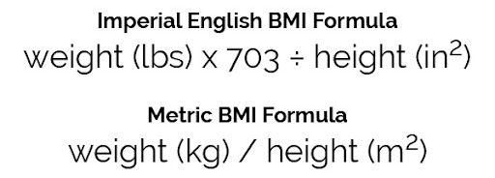
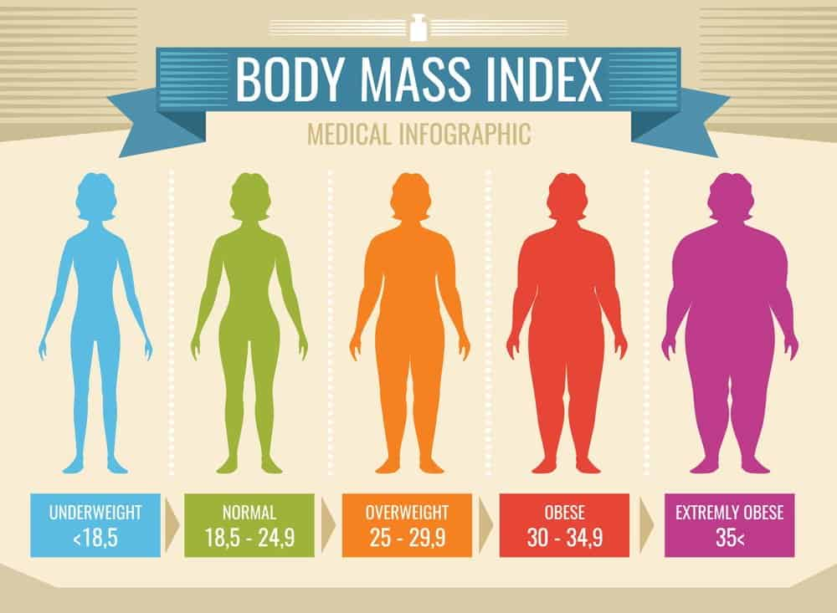
Project Overview
What is BMI?
BMI shows the correlation between your height and weight, it classifies using a formula.
Body mass index (BMI) is the most widely used method to check if you're a healthy weight.
Why is it Important?
The majority of adults were overweight or obese; 67% of men and 60% of women.
– Source NHS UK

Slide 3
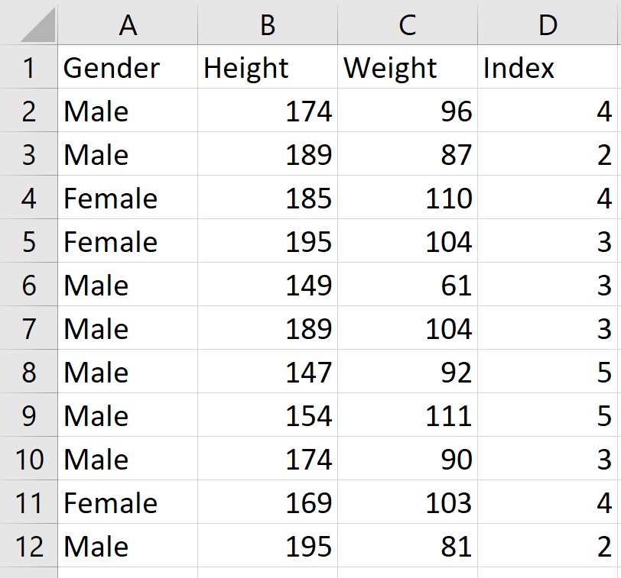

Data Source
KAGGLE
Open Source
Accessible
Excerpt of the data

Slide 4


BMI and Data Science
How to use this data and machine learning?
Train a model on provided BMI data, optimise parameters to improve the performance, and then deploying it into production for global use.
How will Data Science help?
Although BMI is already quantified by a formula, it can provide an accurate and data based predictive method to predict BMIs.

Slide 5
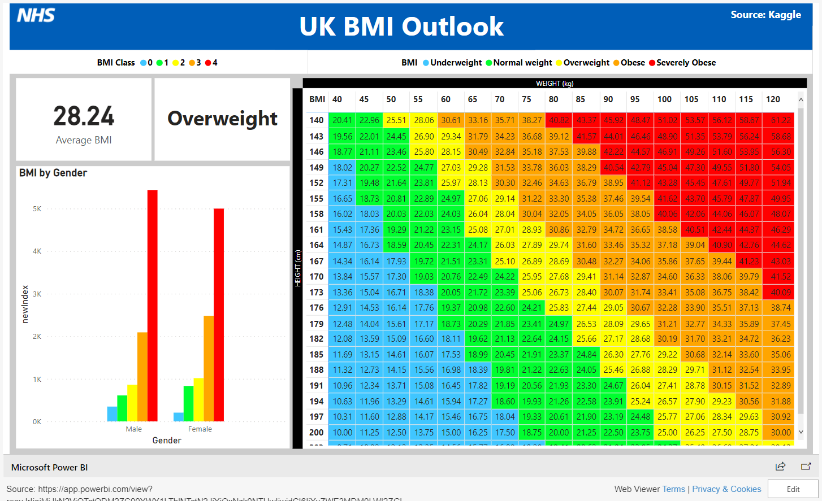
Dashboard

Slide 6
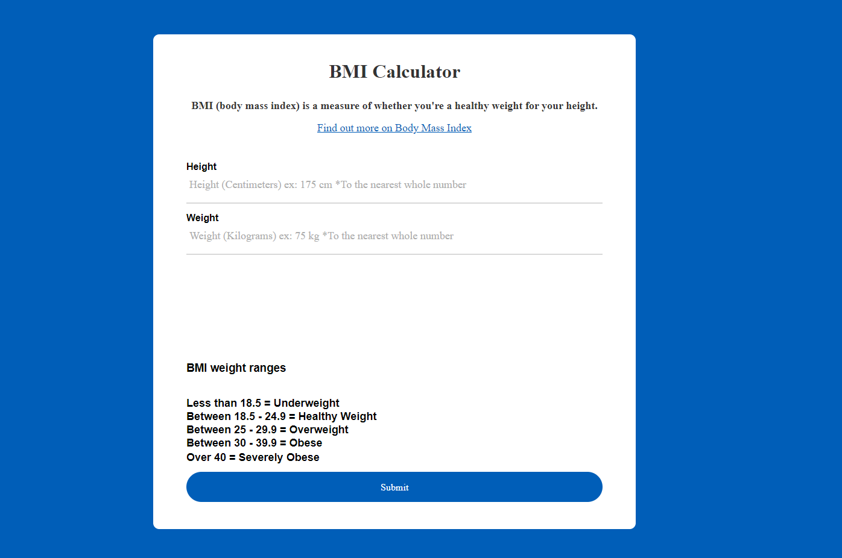
Deployment

Slide 7

Evaluation & Conclusion
The model produced accurate results and is now able to serve global use in production to provide information on BMI and to hopefully being more awareness to the topic.
View Breakdown

Slide 8
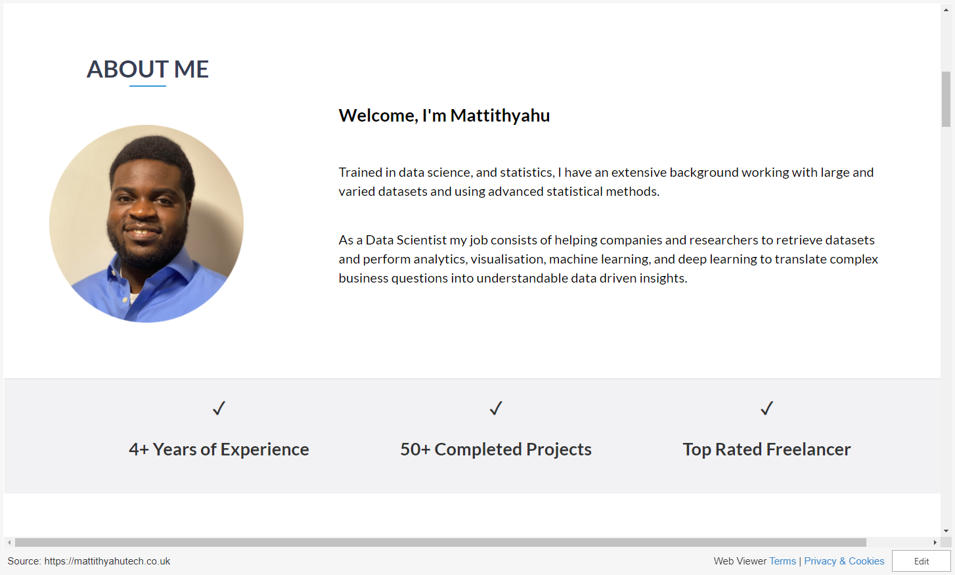

Slide 9
Questions
Thank you for listening.
Questions?

